Slide 1
Exercises
Session 1

Slide 2
What we learned so far
Technical topics that should be considered as understood from now onwards:
Variable assignment
Variable type
Variable names
Script mode VS Interactive mode

Slide 3
What we learned so far
Technical topics that should be considered as understood from now onwards:
Arithmetic operators
Assignment operators
Comparison operators
Logical operators
Incrementing value stored in variable

Slide 4
What we just mentioned
Command line
id(), type() functions
Strings

Slide 5
Print function
It is tool that we use to check what is inside box.
Really useful tool that can be used for debugging also.

Slide 6
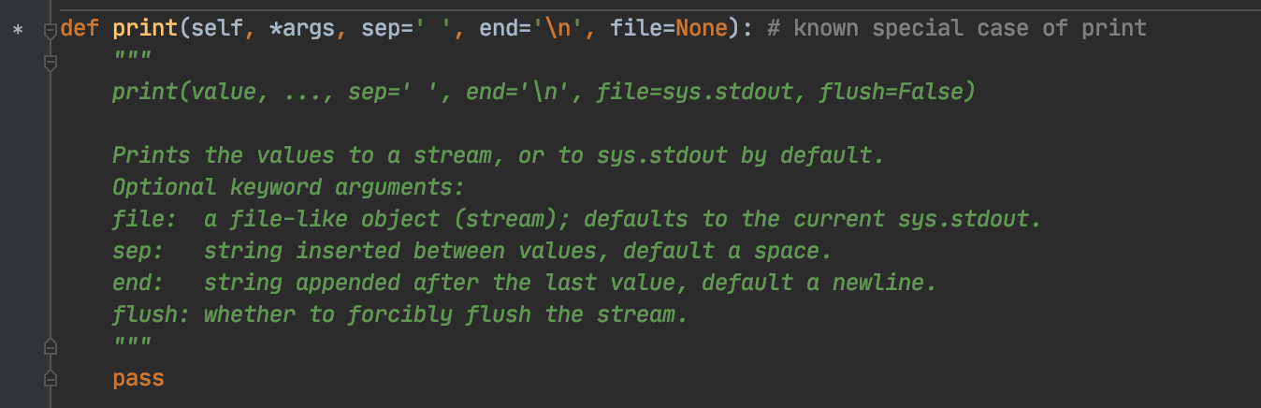
Print function syntax

Slide 7
Exercises
1. Assign value to variable. Check its type. Print what is in the box. Run program interactively and in script mode.

Slide 8
Exercises
Assign values to two variables. Add values. Find difference between two values. Print what was calculated. Run program interactively and in script mode.

Slide 9
Exercises
Assign value to variable. Print what is in box. Increment value by one. Print new value stored in box. Repeat whole process ten times.

Slide 10
Exercises
Find the area of circle with radius 4cm. {r^2 * pi}

Slide 11
Exercises
Find area of rectangle with arbitrary side length.

Slide 12
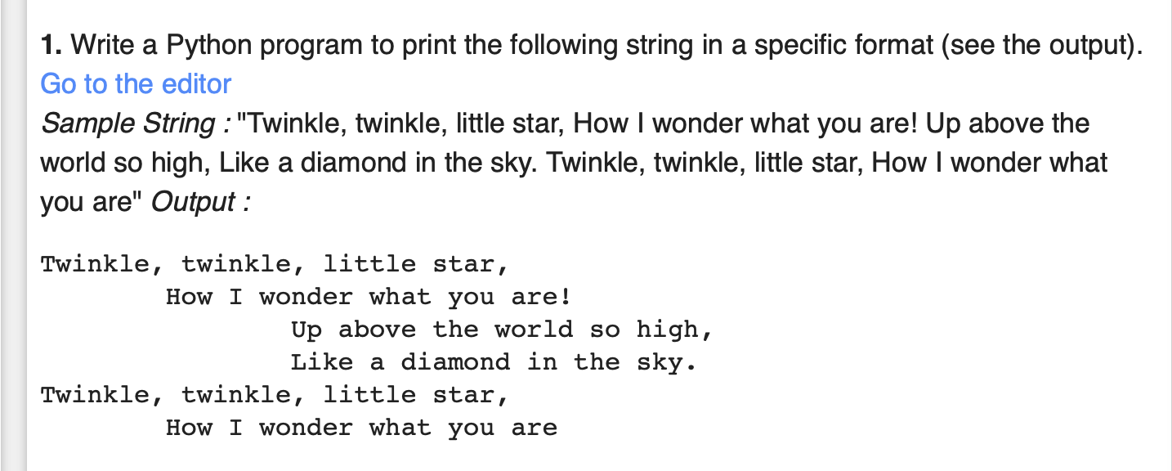
Exercises

Slide 13
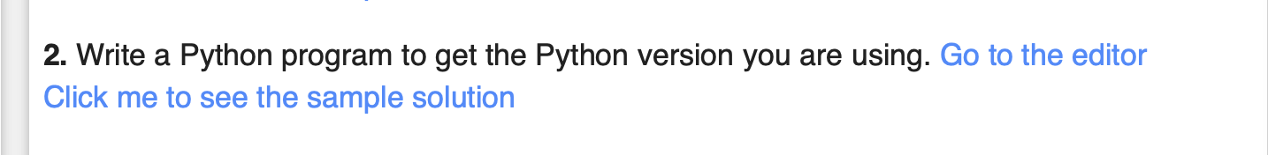
Exercises

Slide 14
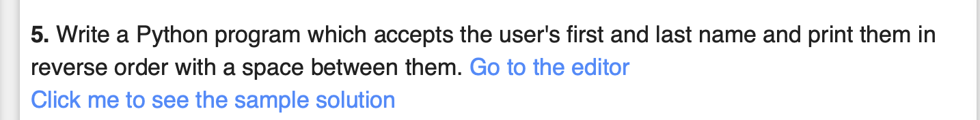
Exercises

Slide 15
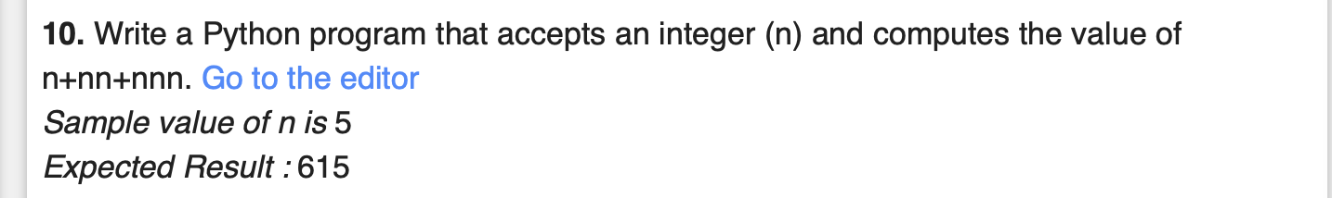
Exercises

Slide 16
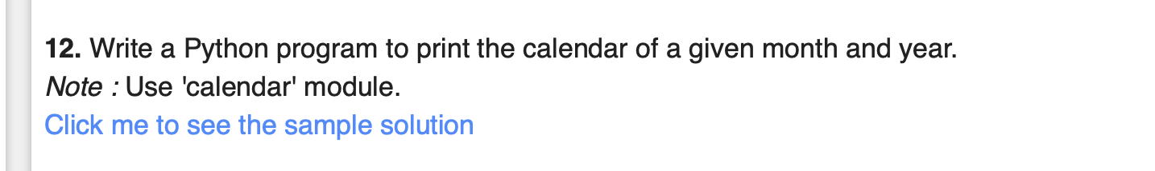
Exercises

Slide 17
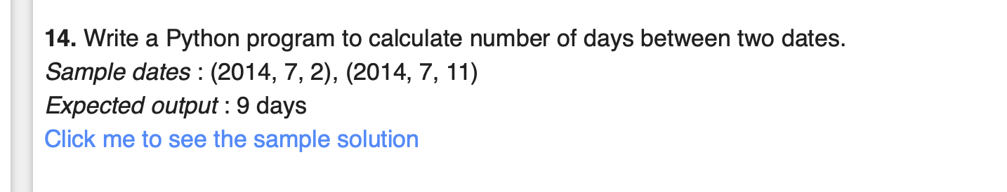
Exercises

Slide 18
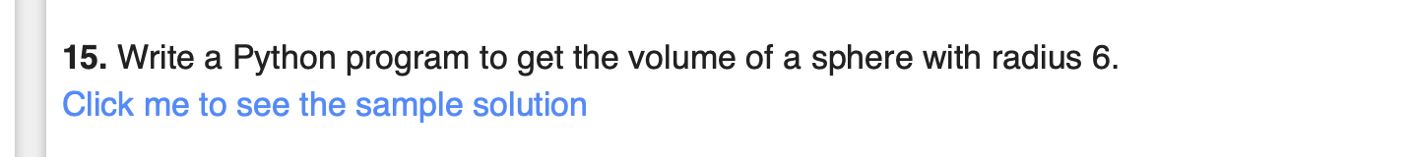
Exercises

Slide 19
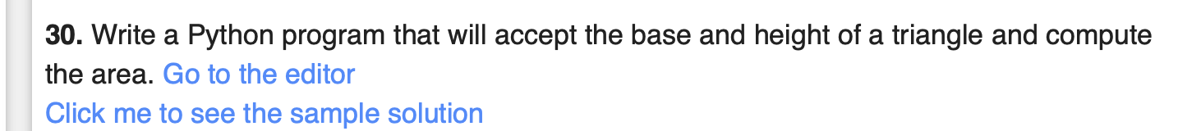
Exercises

Slide 20
Exercises
Check if given number is even or odd.

Slide 21
Exercises

Slide 22
Exercises

Slide 23
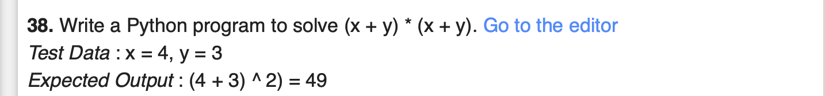
Exercises

Slide 24
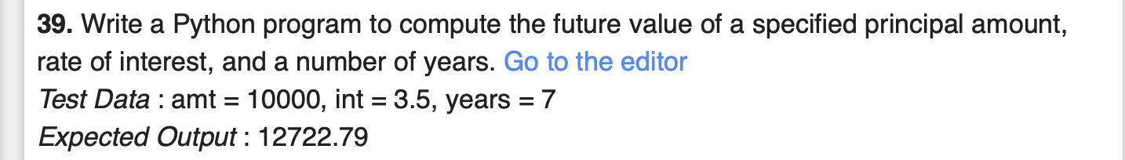
Exercises

Slide 25
Exercises

Slide 26
Exercises

Slide 27
Exercises

Slide 28
Exercises

Slide 29
Exercises

Slide 30
Exercises

Slide 31
Exercises

Slide 32
Exercises

Slide 33
Exercises

Slide 34
Exercises

Slide 35
Exercises

Slide 36
Exercises

Slide 37
Exercises

Slide 38
Exercises

Slide 39
Exercises

Slide 40
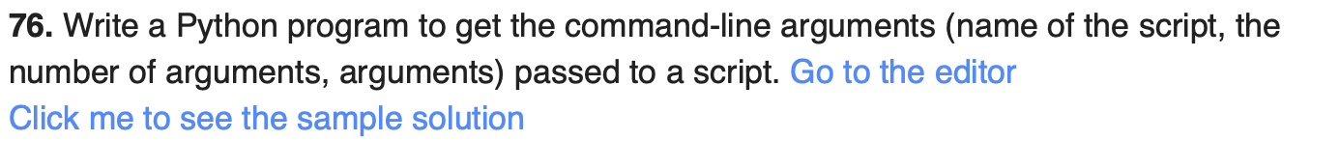
Exercises

Slide 41

Exercises

Slide 42
Exercises

Slide 43
Exercises

Slide 44
Exercises

Slide 45
Exercises

Slide 46
Exercises

Slide 47
Exercises

Slide 48
Exercises

Slide 49
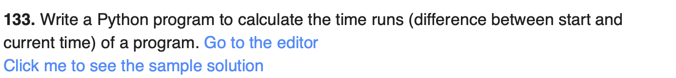
Exercises

Slide 50
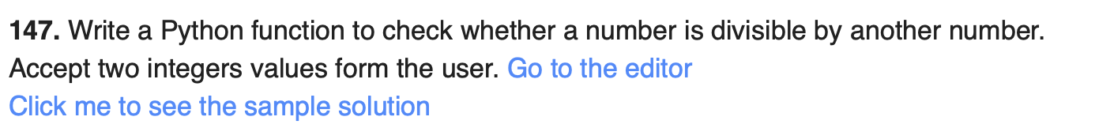
Exercises

Slide 51
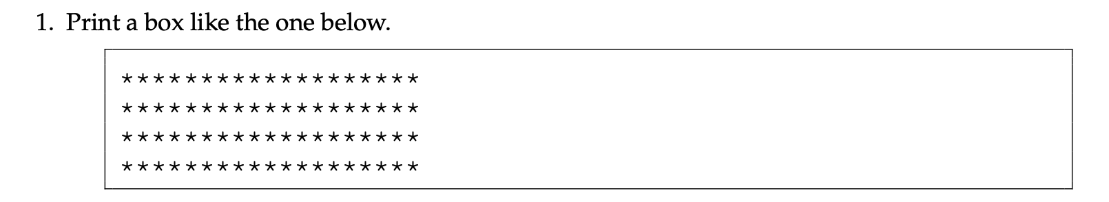
Exercises

Slide 52
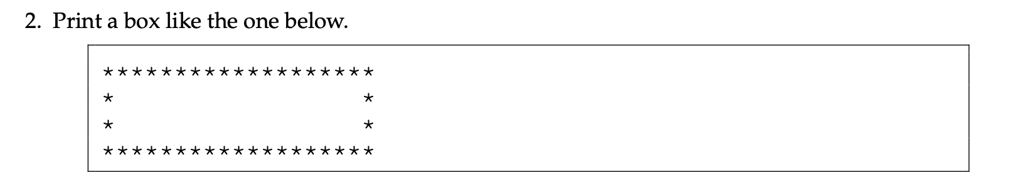
Exercises

Slide 53
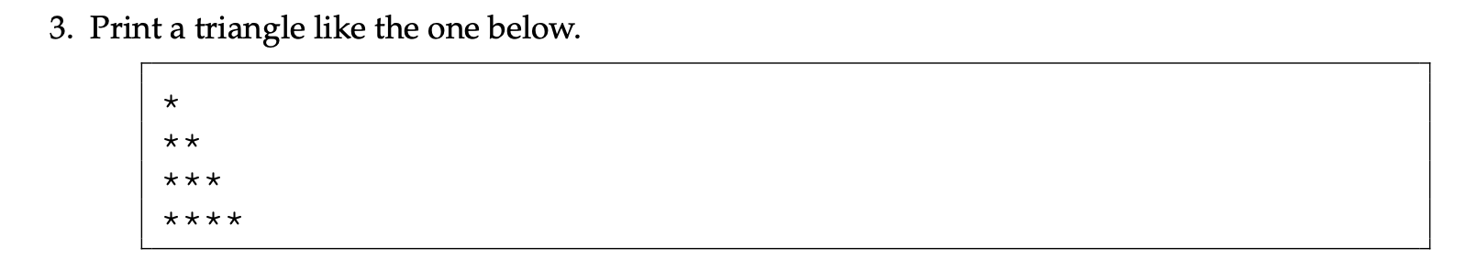
Exercises

Slide 54
Exercises

Slide 55
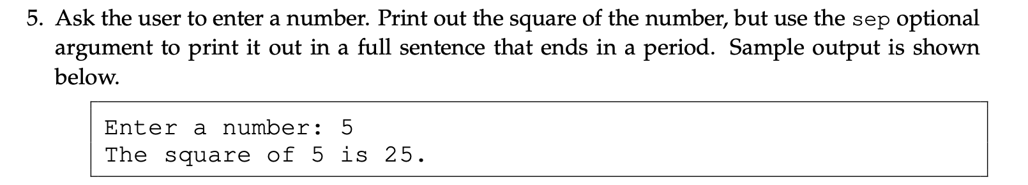
Exercises

Slide 56
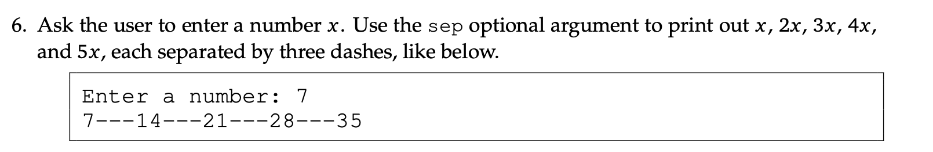
Exercises

Slide 57
Exercises

Slide 58
Exercises

Slide 59
Exercises

Slide 60
The end
Thank you for your most valuable resource. Your time!

